Slide 1




Tablet Masters!
Year 1 Revision · Show what you know
Notes:
Revision lesson, about 45-60 minutes. Resources: one tablet per child or pair, the Tablet Master Quest game (link on the Game slide), slides 3-11 as a warm-up, and a short quiz. All skills are tablet skills: touch and the on-screen keyboard.

Slide 2






Today: 6 missions
1 Technology
2 Parts of a tablet
3 Finger skills
What helps us?
Name the parts
Tap, double-tap, drag
4 Keyboard
5 Fix my writing
6 Stay safe
Type on the screen
Move the cursor, delete
Rules for tablets
Notes:
Lesson plan (about 50 min): Warm-up slides 3-5 (10 min). Finger skills stations slides 6-7 (10 min). Keyboard and fix-it slides 8-9 (10 min). Safety and quiz slides 10-11 (8 min). GAME (15 min). Plenary slides 13-14 (5 min). Lessons 1-6 of the Technology around us unit are covered, with mouse skills turned into finger-touch skills.

Slide 3





Mission 1: What is technology?
Technology is made by people to help us.
Technology ⚙️
Not technology 🌳
Notes:
2 min. Recall Lesson 1: technology is something people made to help us. A tablet, clock and torch are technology; a tree, dog and cloud are not. Ask: How does a tablet help us? (take photos, draw, learn). Quick thumbs-up, thumbs-down game with more examples.

Slide 4
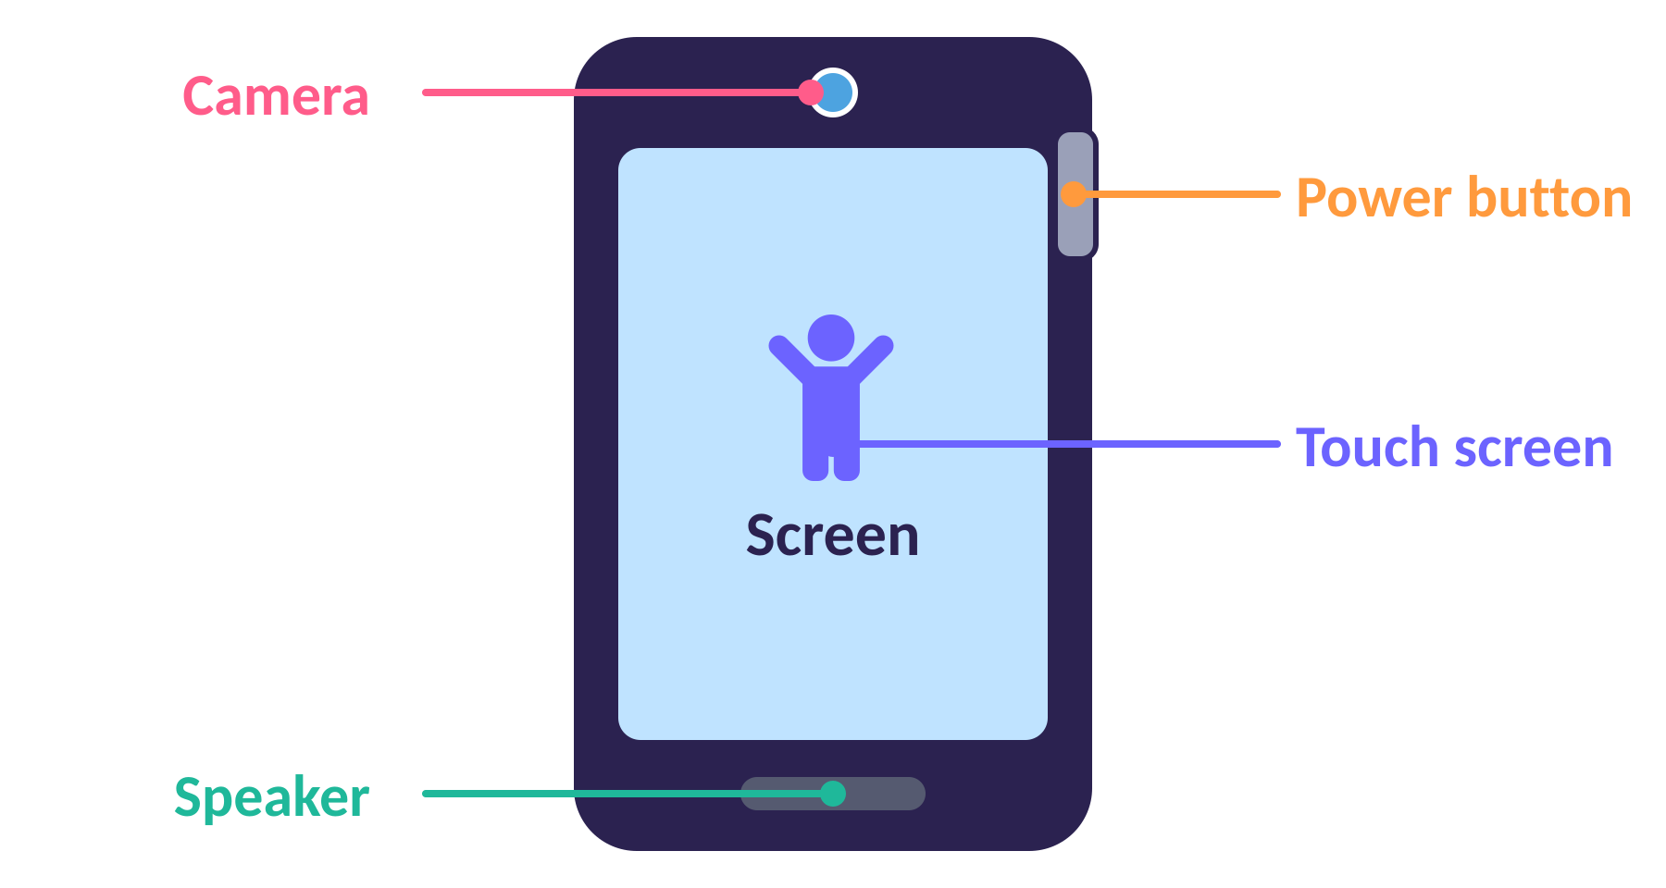
Mission 2: Parts of a tablet
Notes:
3 min. Point to each part on a real tablet. Ask pupils to point to the same part on their own tablet: camera, screen, speaker, power button. Quick-fire: "Show me the camera!" Mouse and keyboard on a computer become touch screen and on-screen keyboard on a tablet.

Slide 5


Switching on the tablet
1
2
3
Press the power button
Swipe up on the screen
Tap the app you want
Notes:
2 min. Lesson 2: switching on and logging in. On the school tablets: press the power button, swipe up, enter the code if needed, then tap an app. Pupils practise on their own tablet.

Slide 6



Mission 3: Finger skills
TAP
DOUBLE-TAP
DRAG
DRAW
one quick touch
two quick taps
touch, slide, let go
slide your finger to make a picture
(like a click)
(like a double-click)
(like click and drag)
(like drawing with a mouse)
Notes:
4 min. In Lessons 2 and 3 we learned click, double-click, and click-and-drag with a mouse. On a tablet we use our finger: tap, double-tap, drag. Mime each one together, then pupils try each on their tablet.

Slide 7
Finger challenge!
TAP 3 times on the screen
Count out loud
DOUBLE-TAP an app to open it
Two quick taps
DRAG an app to a new place
Touch, slide, let go
DRAW a picture with your finger
Open the drawing app
Notes:
5 min. Pupils do each challenge on their tablet and show a partner. Check that they touch with one finger and let go cleanly when dragging. Adapt app names to what is on your tablets.

Slide 8
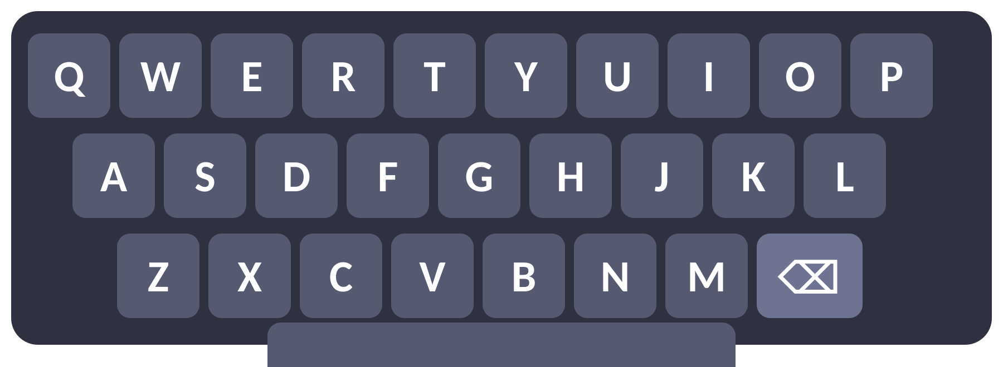


Mission 4: The on-screen keyboard
Tap a letter to type it
Type your name
Tap the save icon to keep your work
Typing means writing with a keyboard. On a tablet the keyboard appears on the screen when we tap a text box.
Notes:
5 min. Lesson 4: typing our name and saving. Pupils open the drawing or notes app, tap the text box so the keyboard appears, type their name and tap the save icon (a floppy disk or a tick/save button). Capital letters are fine for now.

Slide 9


Mission 5: Fix my writing
Oops! There is a mistake.
C A A T
C A T
Tap between the letters
Tap the delete key
Type the right letter
to move the cursor
to rub out a letter
to fix it
Notes:
5 min. Lesson 5: editing text. On a tablet there are no arrow keys on the keyboard, so we TAP between letters to move the text cursor (the blinking line) instead of using the arrow keys. Then use the delete key (backspace) to rub a letter out. Try: CAAT to CAT, DAOG to DOG. Pupils open a saved file and fix a sentence.

Slide 10






Mission 6: Use tablets safely
Hold it with two hands
No drinks near the tablet
Do not run with it
Tell a teacher if something looks wrong
Rest your eyes. Take breaks
Be kind. Take turns
Notes:
4 min. Lesson 6: rules help keep us safe and healthy. Ask why each rule matters, then ask pupils for one more rule. Link to the school IT rules.

Slide 11
Stand up or sit down!
True = stand up · False = sit down
1. A tablet is technology.
2. A tree is technology.
3. We tap the screen with our finger.
4. We can drink next to the tablet.
5. Tapping between letters moves the cursor.
Notes:
5 min. Answers: 1 True, 2 False, 3 True, 4 False, 5 True. Ask a pupil to explain each answer. Optionally add more statements.

Slide 12







Game time!
Finger & Typing Fun
nbc-01z.pages.dev › Year 1
Tap
Double-tap
Drag
Draw
Words
My name
Fix it
7 levels · about 10 minutes · finish them all!
Notes:
15 min. Pupils open the hub on their tablet, tap Year 1, then Finger & Typing Fun. They use only their finger and the on-screen keyboard, and there is no sound. Levels: tap, double-tap, drag and drop, draw and join the dots, type words, longer words and their name, and fixing writing. Walk round and watch for pupils struggling with double-tap or dragging. Teacher shortcut: add ?level=3 to the web address to jump to a level.

Slide 13
I can…
I can say what technology is
I can name the parts of a tablet
I can tap, double-tap and drag
I can type my name on the screen
I can fix a mistake in my writing
I can use a tablet safely
Notes:
3 min. Thumbs up, sideways or down for each statement. Note who needs more practice with each skill.

Slide 14
Well done, Tablet Masters!
Great learning, Year 1
Notes:
Praise effort and note something specific each child did well.

